Slide 1
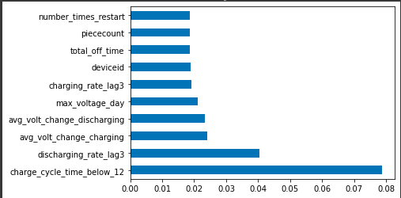
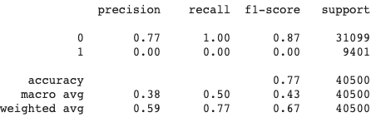
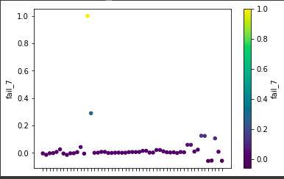
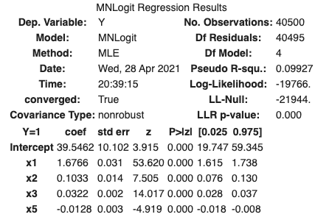
https://colab.research.google.com/drive/14VtwsmdIiFLNhW0ckKIirtt3bC58MUq3?usp=sharing
Predictive Mailing Meter Maintenance
Baruch College: Pitney Bowes Data Challenge
Background Information
Data Understanding
Modeling and Results
Predictions and Evaluations
Metered mail is a very convenient service for small and medium sized businesses
Streamlines a business’s mailing process by conveniently measuring shipping cost, saves on some shipping fees and removes the hassle of going to the post office
Pitney Bowes offers digital mailing meters that empower businesses to send out physical mail, which is still considered to be a very reliable means of communication with customers
Training data set consists of 40,500 entries while the testing data set has 4,500 entries
Among the 55 predictors in the training dataset, fail_7 is the target variable, concerning whether the meter failed in the following 7 days
The data is primarily numeric, with only 3 of the predictors being non-numeric
Data cleaning procedure began by identifying which columns had missing values
There were no missing data entries in the categorical predictors, but there were in the numeric ones
The missing values were imputed by the median of the predictors to preserve all the data.
charge_cycle_time_below_12 was normalized, converted to integer values for further analysis
Found the correlation matrix between the 52 numerical variables and the target variable fail_7 to determine predictor variables
charge_cycle_time_below_12 yielded the highest correlation 0.2893, with avg_volt_change_charging and avg_volt_change_discharging following behind at 0.1246 and 0.1233 respectively
The most important features were selected with an Extra Trees Classifier
A logistic regression model was created by fitting fail_7 and charge_cycle_time_below_12, which had an accuracy of 76.78%
A multivariate logistic regression model with backward elimination was created and further improved by dropping all the insignificant values
Using the Logistic Regression model, a prediction for fail_7 was conducted on based off the test data. The deficiency was 0.7% failure rate.
Conclusion
We noticed that the dataset has high dimensionality because of the multiple lag variables that span over different time frames
The fact that the dataset consists of average values, rates and rates of change, that too is a cause of high dimensionality (units of measurement).
High dimensionality make it difficult to determine which features could be a cause of data leakage, so we need to perform clustering or other dimension reduction methods like PCA.
In addition, because the dataset consists of averages, it eliminates the actual minimum and maximum values that could have been a key determinant of fail-7. This too could be a sign of data leakage.
We feel that the models accuracy could be improved by transforming the data and its parameters - by iterating through preparation process: manipulation, filtering, and scaling the data.
We noticed features that could have been combine; like an interval time [DateDeployed:LastRecord]
We chose to use multivariate logistic regression as our model; because we knew we had to solve a binary classification problem. Additional classification models should be added to form an ensemble to output more accurate predictions.
Problem Statement
Pitney Bowes’s mailing meters are integral system in business operations and downtime can very easily hamper the business’s mailing processes
Thus, the goal is to proactively identify possible meter downtime by looking for signs of system failure.
We need to figure out which factors have the most weight influencing these failures
Once we uncover these factors; then we can successfully predicting when a mailing meter will fail within 7 days.
Pitney Bowes’s can then reach out to clients to deliver a solution; a hopefully seamless experience for clients

